Slide 1
Lighting a room
Katie turns the light on so she can see.
Her dad is asleep in the chair.
Big book of science
UYSEG

Slide 2
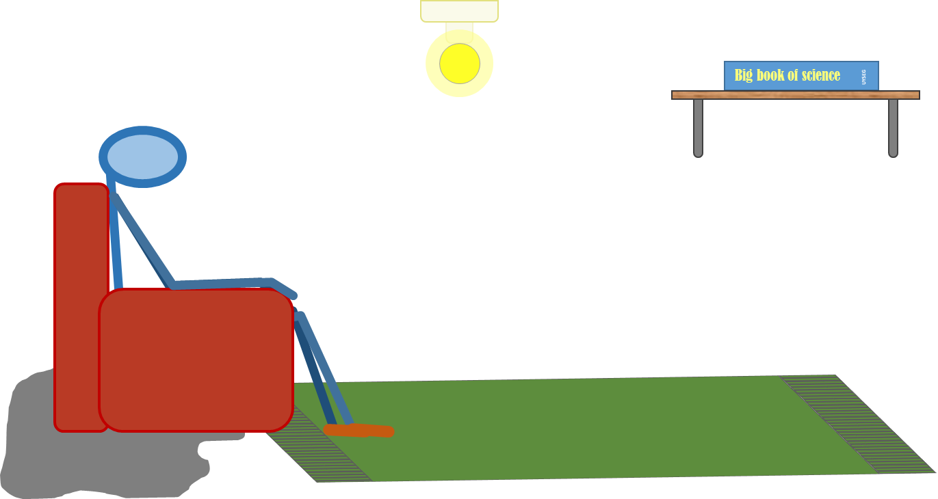
Lighting a room
How does the bulb light the room?
Which of these statements do you think are right?
I am sure this is right
I think this is right
I think this is wrong
I am sure this is wrong
A
Light moves in straight lines from the bulb
B
No light reaches behind dad’s chair where it is darker
C
Light keeps coming out of the bulb and bouncing off things
D
Light flows out of the bulb until it fills the room, then it stops moving

